Slide 1
Enhancement of GG Data Collection Practices IDT Collaboration Staff Training
Emily Miller, Administrator
Krystle Schuette, LPN, Quality Assurance
Joni Clifton, PTA, Director of Therapy

Slide 2
Enhancement of GG Data Collection Practices, IDT Collaboration and Staff Training
Lutheran Care Center is a not-for-profit, faith-based nursing facility with skilled nursing and long-term care.
Audits
Prompted a review of our documentation and procedures
Began implementing changes in January 2025
Ongoing updates

Slide 3
Enhancement of GG Data Collection Practices, IDT Collaboration and Staff Training
IDT Response to Audit denials/appeals
Participated in education training/resources re: MDS and Section GG
RAI Manual
Various online trainings
Updated forms
Functional Abilities Performance Logs
GG Summary

Slide 4
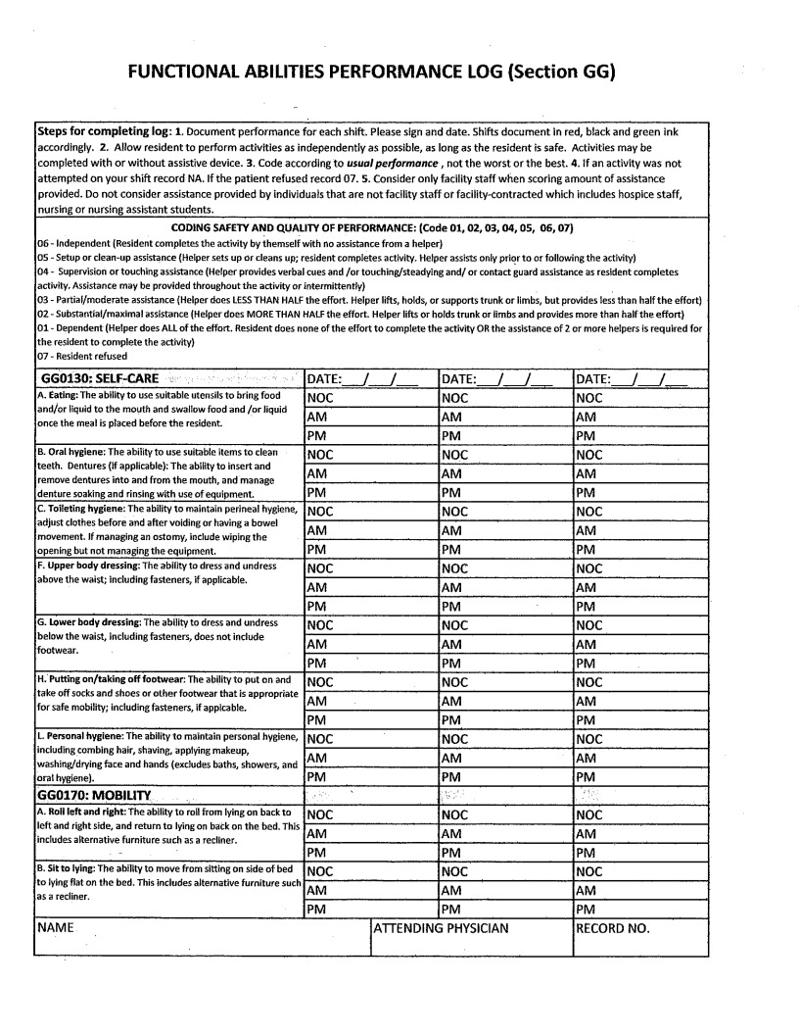
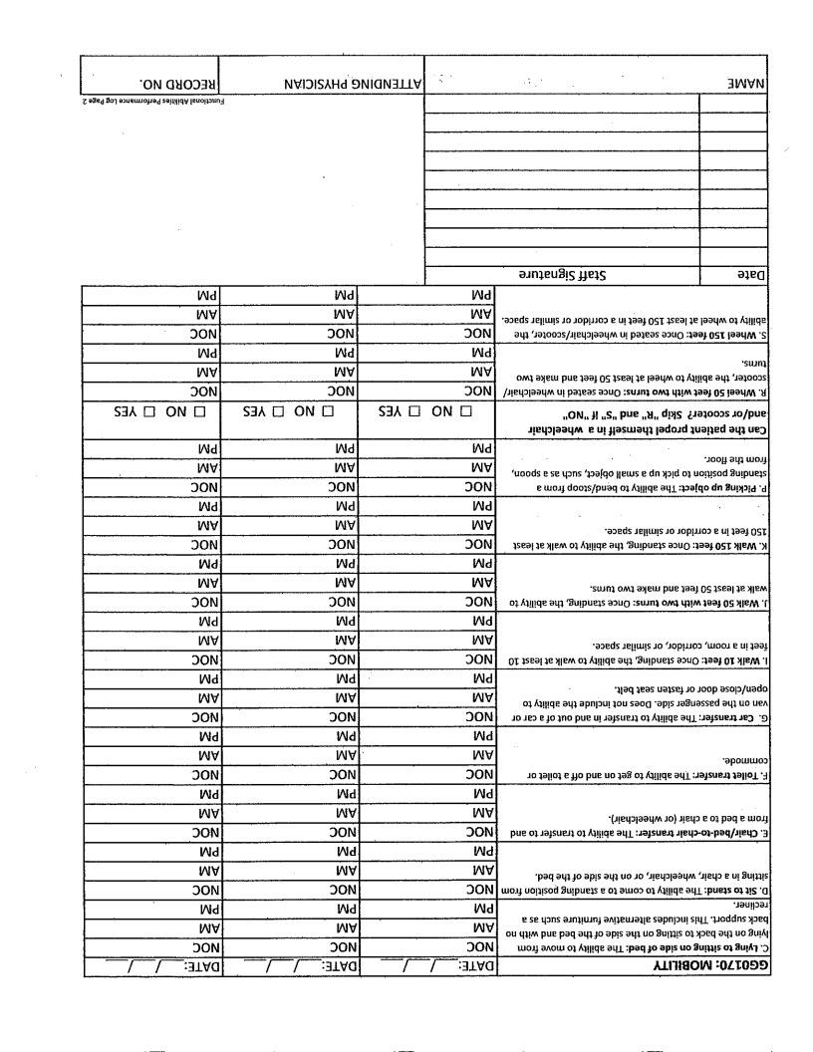
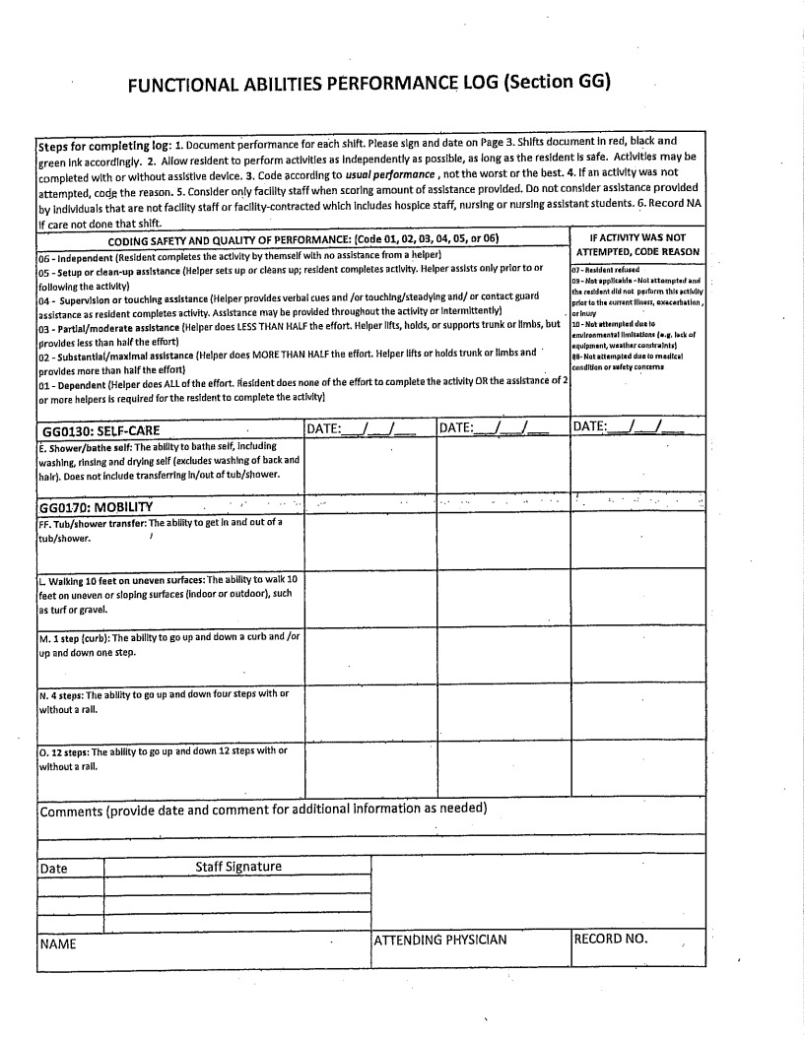
Enhancement of GG Data Collection Practices, IDT Collaboration and Staff Training

Slide 5
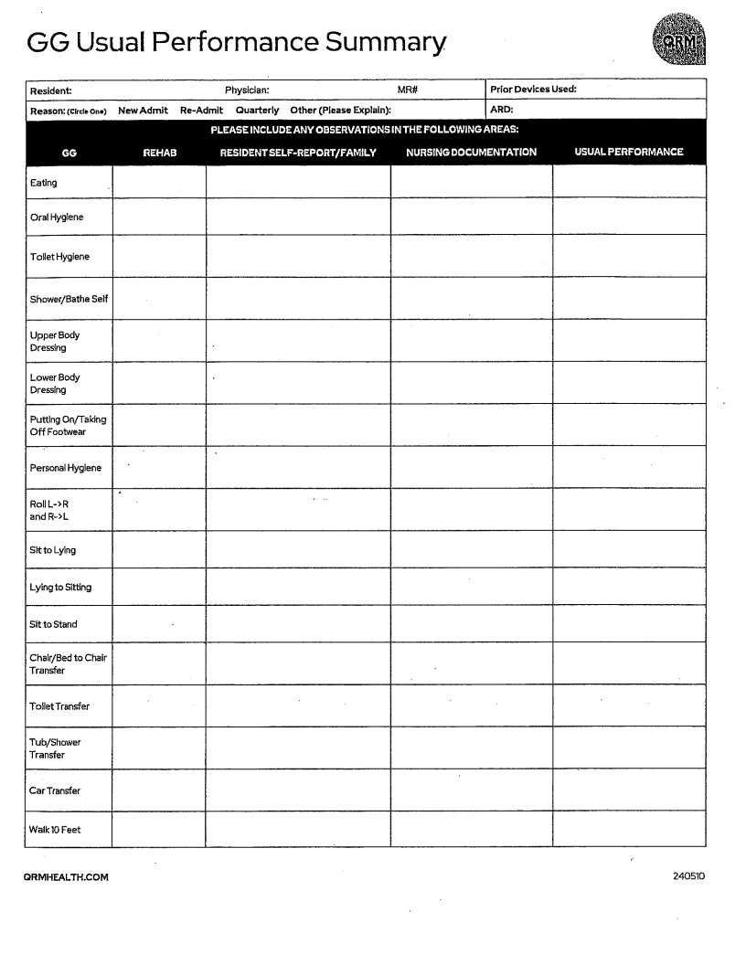
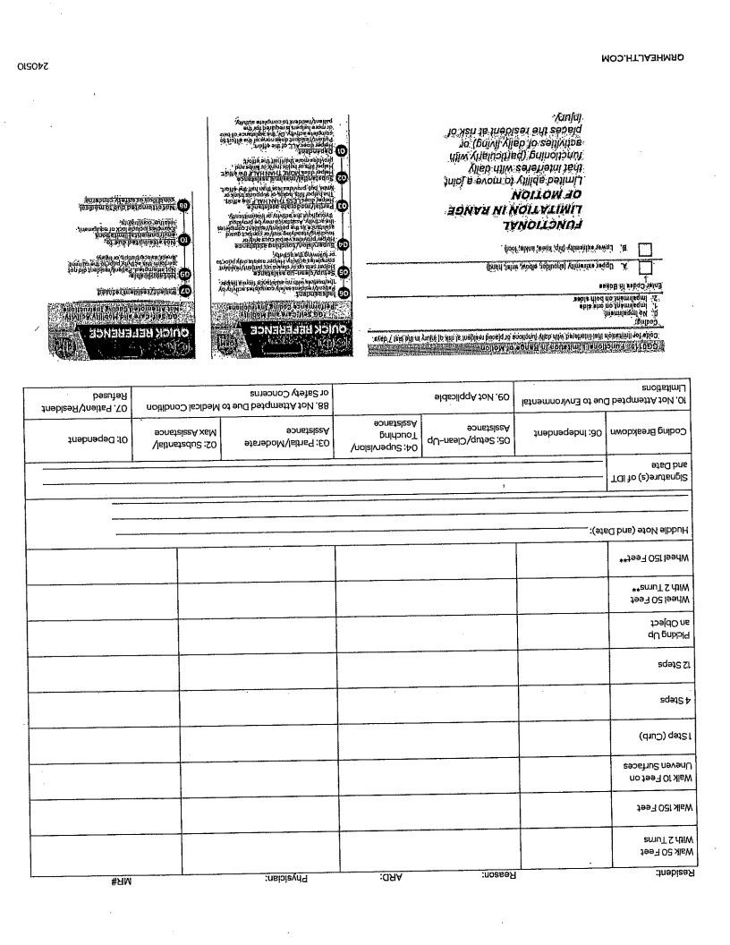
Enhancement of GG Data Collection Practices, IDT Collaboration and Staff Training

Slide 6
Enhancement of GG Data Collection Practices, IDT Collaboration and Staff Training
IDT Response to Audit denials/appeals (cont)
Provided staff training
IDT
Staff Huddle
One-on-one CNA training – Functional Abilities Performance Log
Tip of the Week – One Self-Care or Mobility Item

Slide 7

Enhancement of GG Data Collection Practices, IDT Collaboration and Staff Training
Upper Body Dressing – The Ability to dress and undress above the waist; including fasteners, if applicable.
Items used for coding include: bra, undershirt, T-shirt, button-down shirt, pullover shirt, dresses, sweatshirt, sweater, nightgown (not hospital gown), and pajama top. Upper body dressing cannot be assessed based solely on donning/doffing a hospital gown. Include assistance with buttons, fasteners and/or fastening a bra.
Example: Resident K sustained a spinal cord injury that has affected both movement and strength in both upper extremities. They place their left hand into one-third of their left sleeve of their shirt with much time and effort and are unable to continue with the activity. A certified nursing assistance then completes the remaining upper body dressing for Resident K.
Coding: 02, Substantial/maximal assistance.
Rationale: Resident K can perform a small portion of the activity but requires the assistance by a helper for more than half of the effort.

Slide 8
Enhancement of GG Data Collection Practices, IDT Collaboration and Staff Training
IDT Response to Audit denials/appeals (cont)
Ongoing review and collaboration
Quality Assurance meeting 2x/week
Nursing team meets daily

Slide 9
Enhancement of GG Data Collection Practices, IDT Collaboration and Staff Training
Data Collection
Functional Abilities Performance Log (CNA/nursing)
Functional Abilities Performance Log
Therapy Documentation
Nursing Documentation
Patient Observation
Patient/family Report
Staff Interview

Slide 10
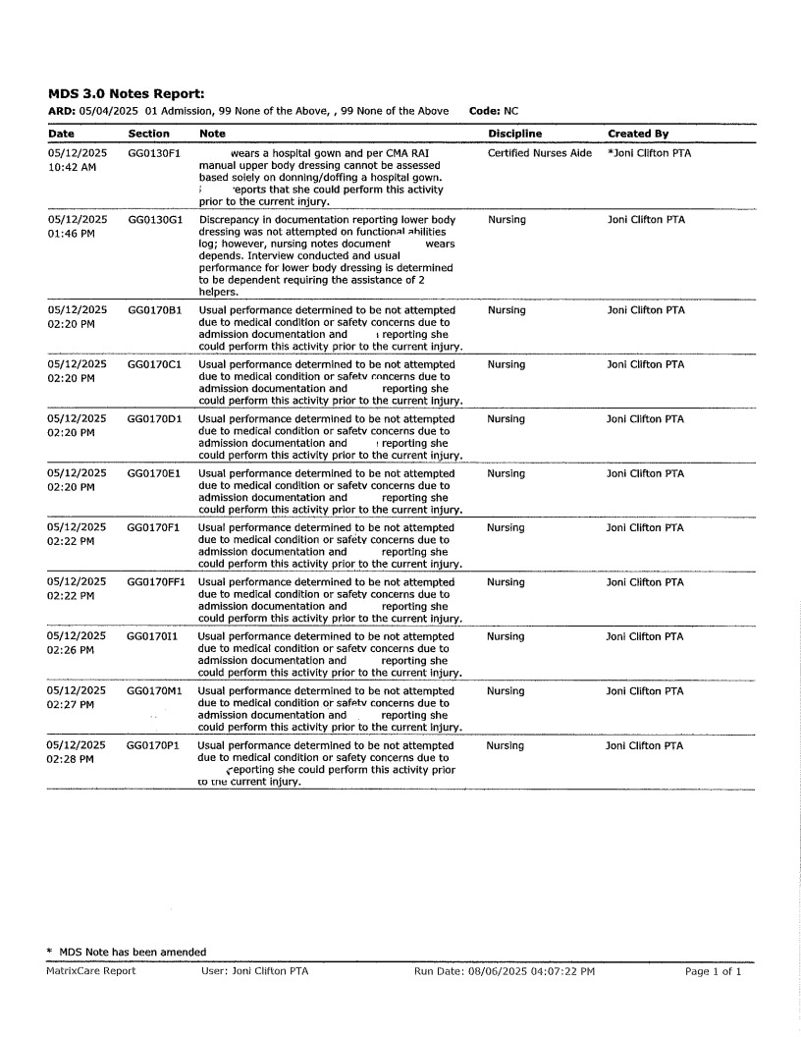
Enhancement of GG Data Collection Practices, IDT Collaboration and Staff Training
Functional Performance Discrepancies
Make notes on GG Summary
Comment in notes section on the MDS when there is a discrepancy between disciplines to give coding rationale

Slide 11
Enhancement of GG Data Collection Practices, IDT Collaboration and Staff Training
Summary
Improved communication between staff
Information is more accurate
Positive feedback from staff
Successful and will continue to utilize

Slide 12

Enhancement of GG Data Collection Practices, IDT Collaboration and Staff Training

Slide 13

Enhancement of GG Data Collection Practices, IDT Collaboration and Staff Training

