Slide 1
An Overview of SAIDO Learning and the Effect on QMs

Slide 2
SAIDO Learning: review of topics
What is SAIDO Learning?
How is SAIDO Learning Effective?
Activating the Brain
Signs of Improvement

Slide 3
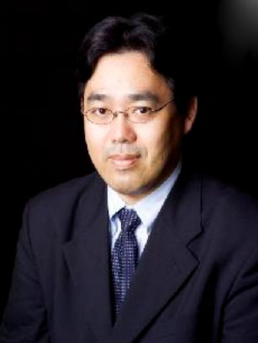
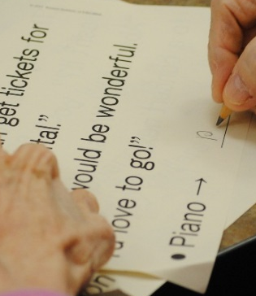

History of SAIDO Learning
Tohoku University
Research &
Scientific Demonstration
Kumon Institute
of Education
Materials &
Method Development
Eijuen
Nursing Home
Field Testing &
Implementation

Slide 4
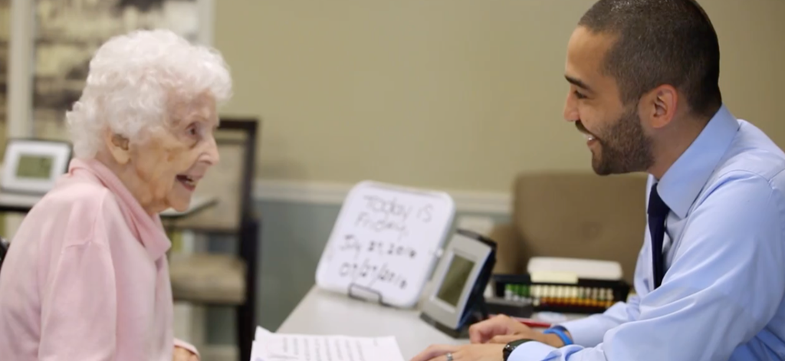
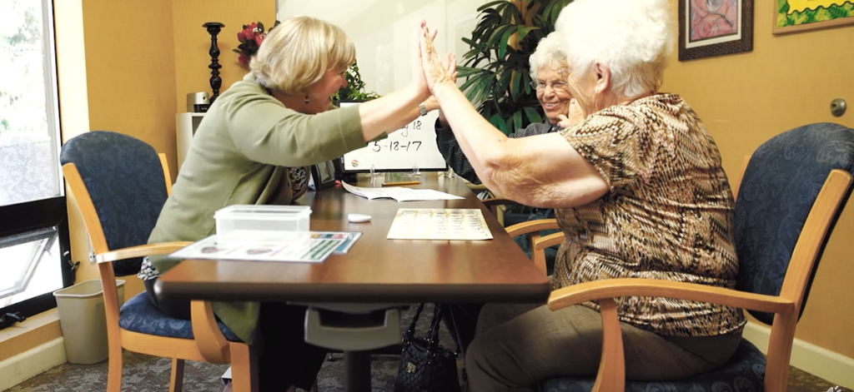
What is SAIDO Learning?
SAIDO Learning is a non-pharmacological program based on a learning intervention offering mental exercises and an opportunity for enhancing individual engagement with staff and others in everyday life.

Slide 5
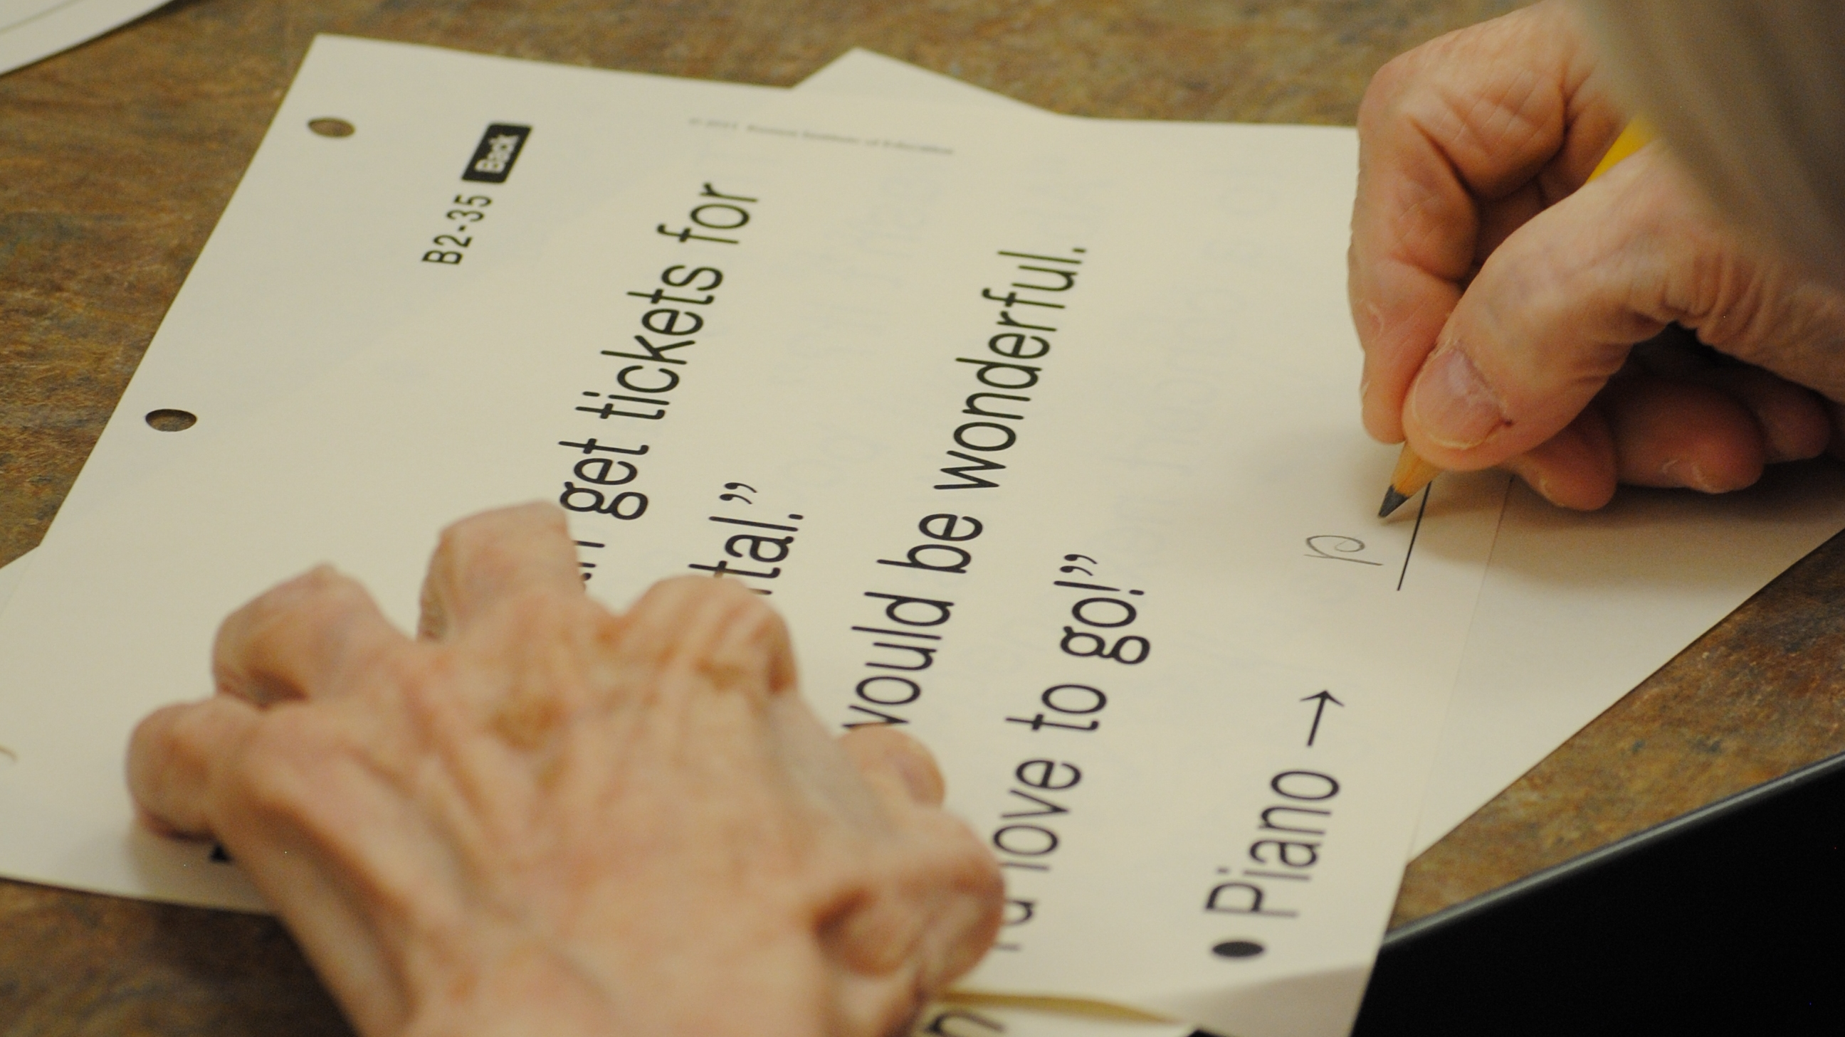

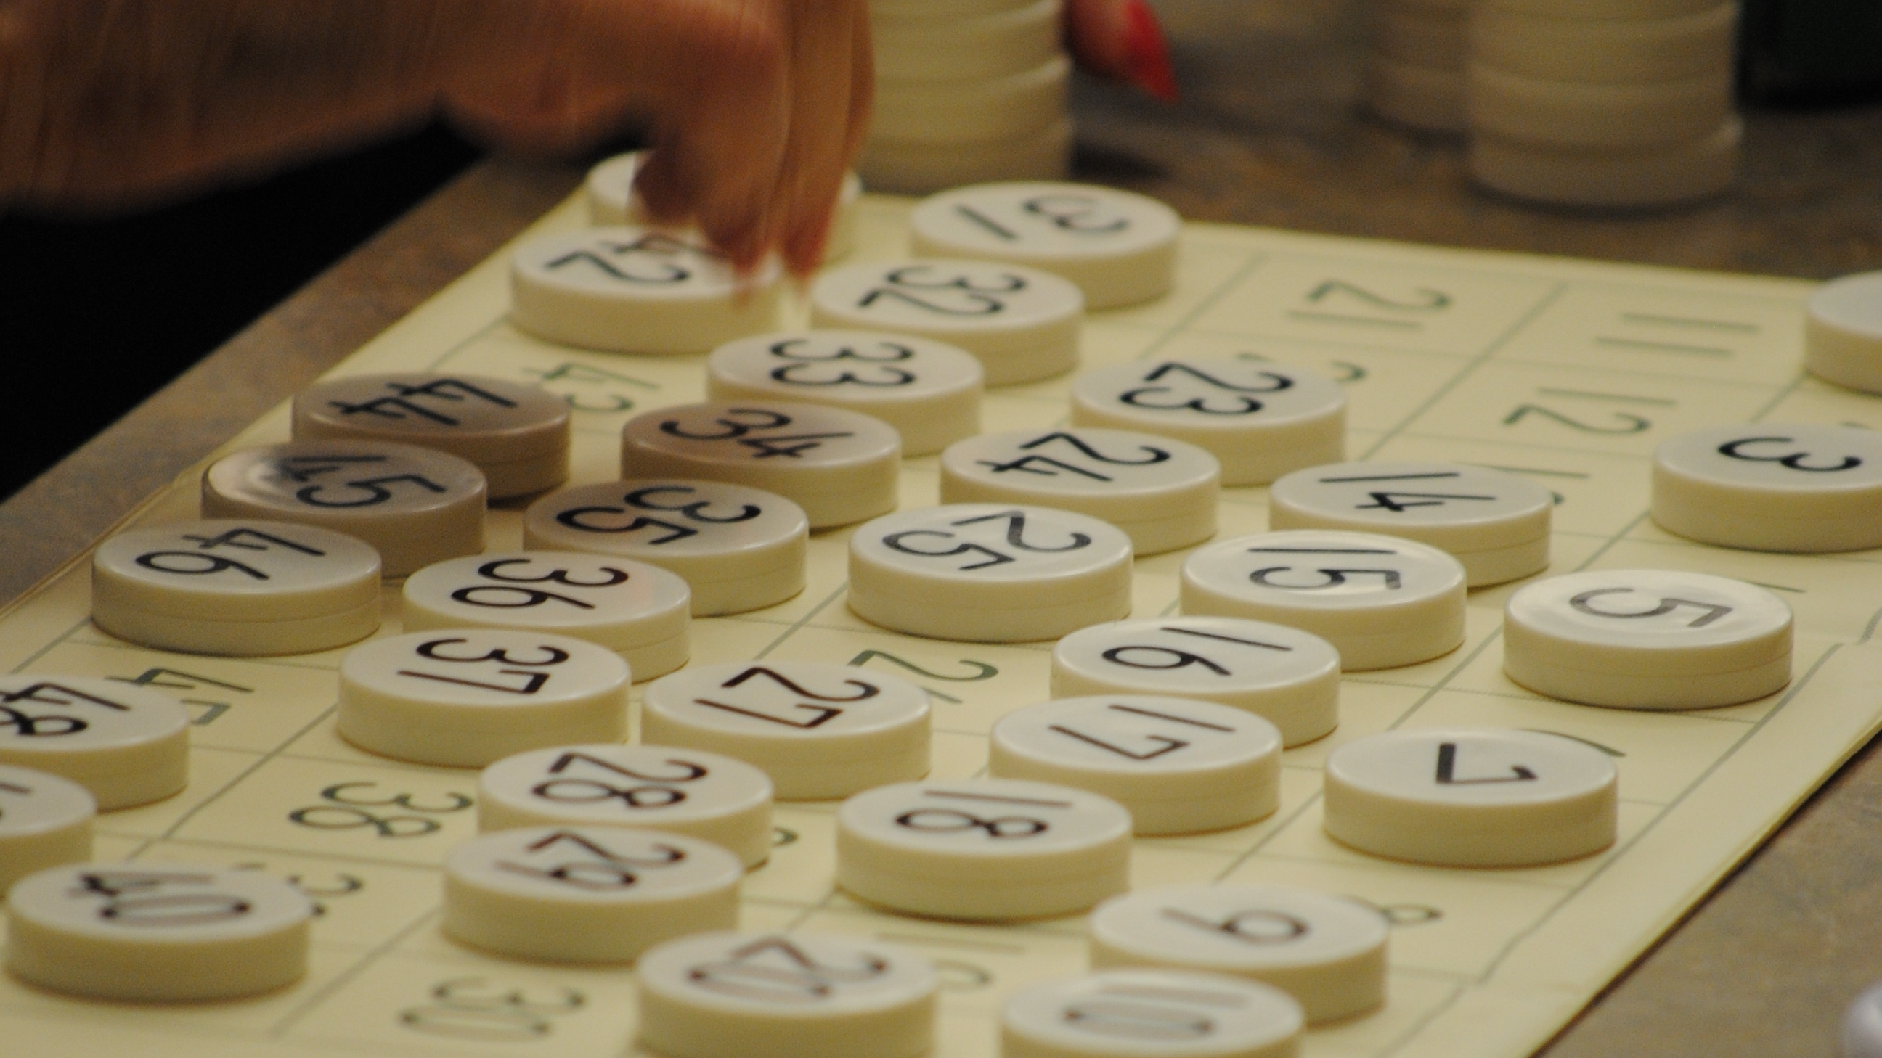
What is involved in a
SAIDO Session?
30 minutes
5 Days/Week
Comprised of:
Reading and Writing Worksheets
Math Worksheets
Number Board Exercise
Positive Communication and Praise
Just Right Level

Slide 6
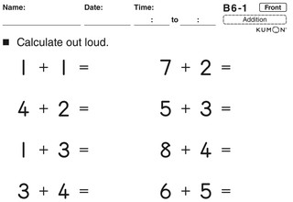
Arithmetic Worksheet

Slide 7
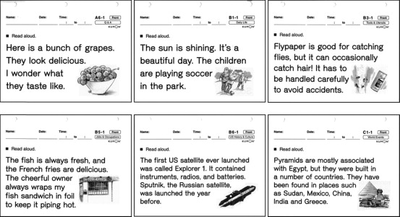
Reading and Writing Worksheets

Slide 8
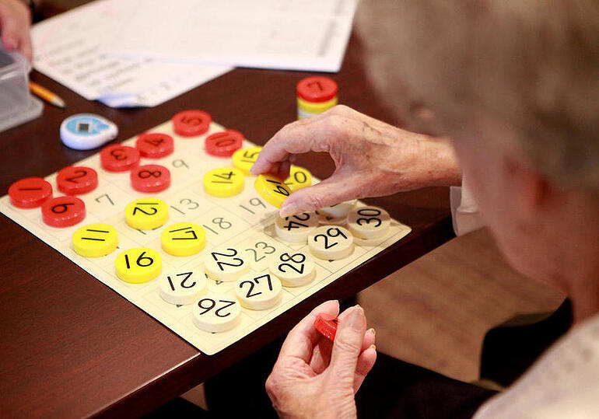
Number Board

Slide 9
How do we know that SAIDO Learning is Effective?
DIAGNOSTIC TESTS – PRIOR TO AND EVERY 6 MONTHS THEREAFTER. Empirical data on the effectiveness of SAIDO Learning, as measured by standard cognitive testing instruments, show measurable improvement of cognitive function in older adults with dementia.
Results also include higher levels of activity, enhanced life satisfaction, increased energy, and social engagement among older adult participants.
SAIDO Learning is being practiced, with stunning results, by nearly 18,000 Learners in 1,600 nursing facilities across Japan.
OBSERVATIONS BY FAMILY AND STAFF. Results also include higher levels of activity, enhanced life satisfaction, and increased energy and social engagement among older adult participants.

Slide 10
Activating the Brain
The brain is mostly activated by three important factors. This information is documented through years of research and study.
1.) Reading aloud
2.) Solving simple math problems
3.) Positive communication and praise

Slide 11
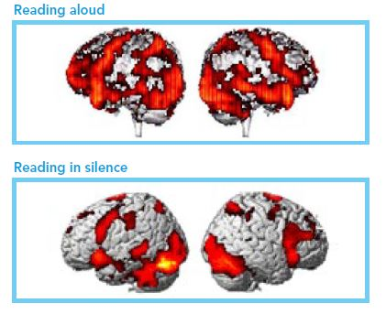
Findings from Studies Using Functional MRI

Slide 12
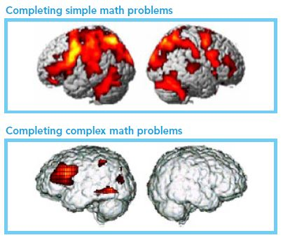
Findings from Studies Using Functional MRI

Slide 13
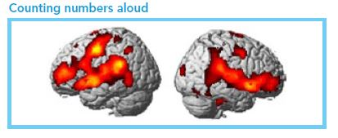
Findings from Studies Using Functional MRI

Slide 14
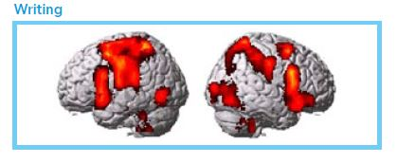
Findings from Studies Using Functional MRI

Slide 15
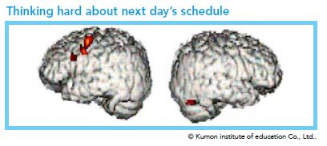
Findings from Studies Using Functional MRI

Slide 16
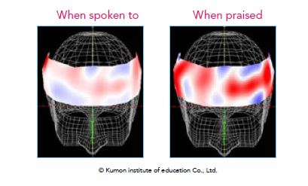
Findings from Studies Using Functional MRI

Slide 17
Signs of Improvement
Changes we have seen through SAIDO include:
improved mood regulation and impulse control,
increased independence and confidence,
improved ability to perform activities of daily living,
increased social engagement,
the ability to recall staff and loved ones by name,
decreased isolation, anxiety and depression,
and much more.

Slide 18

Why SAIDO Learning?
Learners:
“Thank you to your team for helping improve my life when I did not see any hope in my future.”
Learner’s Families:
“For one brief moment, we were disease free and connected to something more powerful.”
“I’m not sure what you are doing, but it’s like we have the old Barbara back again.”
Employees & Volunteers:
“SAIDO Sessions are the best part of my day.”

Slide 19
Learner Success Story: Jim
Often Displayed exit seeking behaviors in the afternoon, looking for a ride home and becoming agitated.
SAIDO became a great tool to help verbally redirect him and provide an activity to occupy his mind.
After being asked to join the supporter at the table to complete worksheets, Jim could be easily redirected away from the front door.
He often finished sessions in a better mood than he was in when he started, as he felt proud of his accomplishments and relished in the feeling of productivity.
One supporter said: “Jim is in a better mood once he does SAIDO. Sometimes he is confused and crabby beforehand, but is in better spirits and smiling once he does SAIDO.”

Slide 20
Learner Success Story: Tom
Tom started engaging with SAIDO after a stroke left him with visual and cognitive deficits.
Tom has found the math and reading exercises helpful towards his progress in his stroke recovery.
During many of his sessions, the different reading materials have helped trigger memories from his past that he enjoys discussing with his supporter.
Tom often remarks that “I need this for my stroke” and that “this is important to me”.
Participating in SAIDO has helped Tom feel more autonomy over his cognition and he enjoys having a project to work on.

Slide 21
Improvement Data
Depressive symptoms (PHQ2-9) – 1st quarter 2024 (11.8%) vs 1st quarter 2025 (5.0%)
Antipsychotic med use – 2nd quarter 2024 (33.3%) vs 2nd quarter 2025 (18.8%)
Residents whose need for help with ADLs has increased – 2nd quarter 2024 (26.3%) vs 2nd quarter 2025 (7.7%)
Residents whose ability to move independently has worsened – 2nd quarter 2024 (13.3%) vs 2nd quarter 2025 (9.1%)

Slide 22


