Slide 1
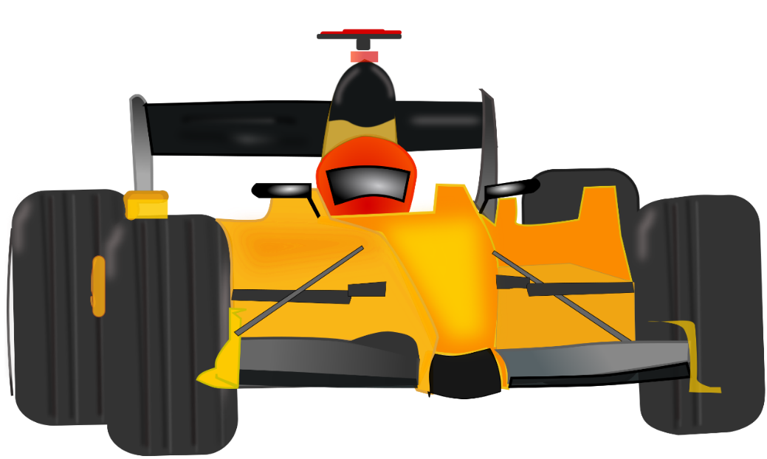
Best Practice Presentation
by Bartels Lutheran Retirement Community
Wound Care Principles
Drive the Protocols
Wound Care Principles
Drive the Protocols
Angie Ellerbroek, RN, BSN, CWON
Infection Prevention Nurse
aellerbroek@bartelscommunity.org
Notes:
Updating Wound Care Protocols to follow current evidence-based practice

Slide 2
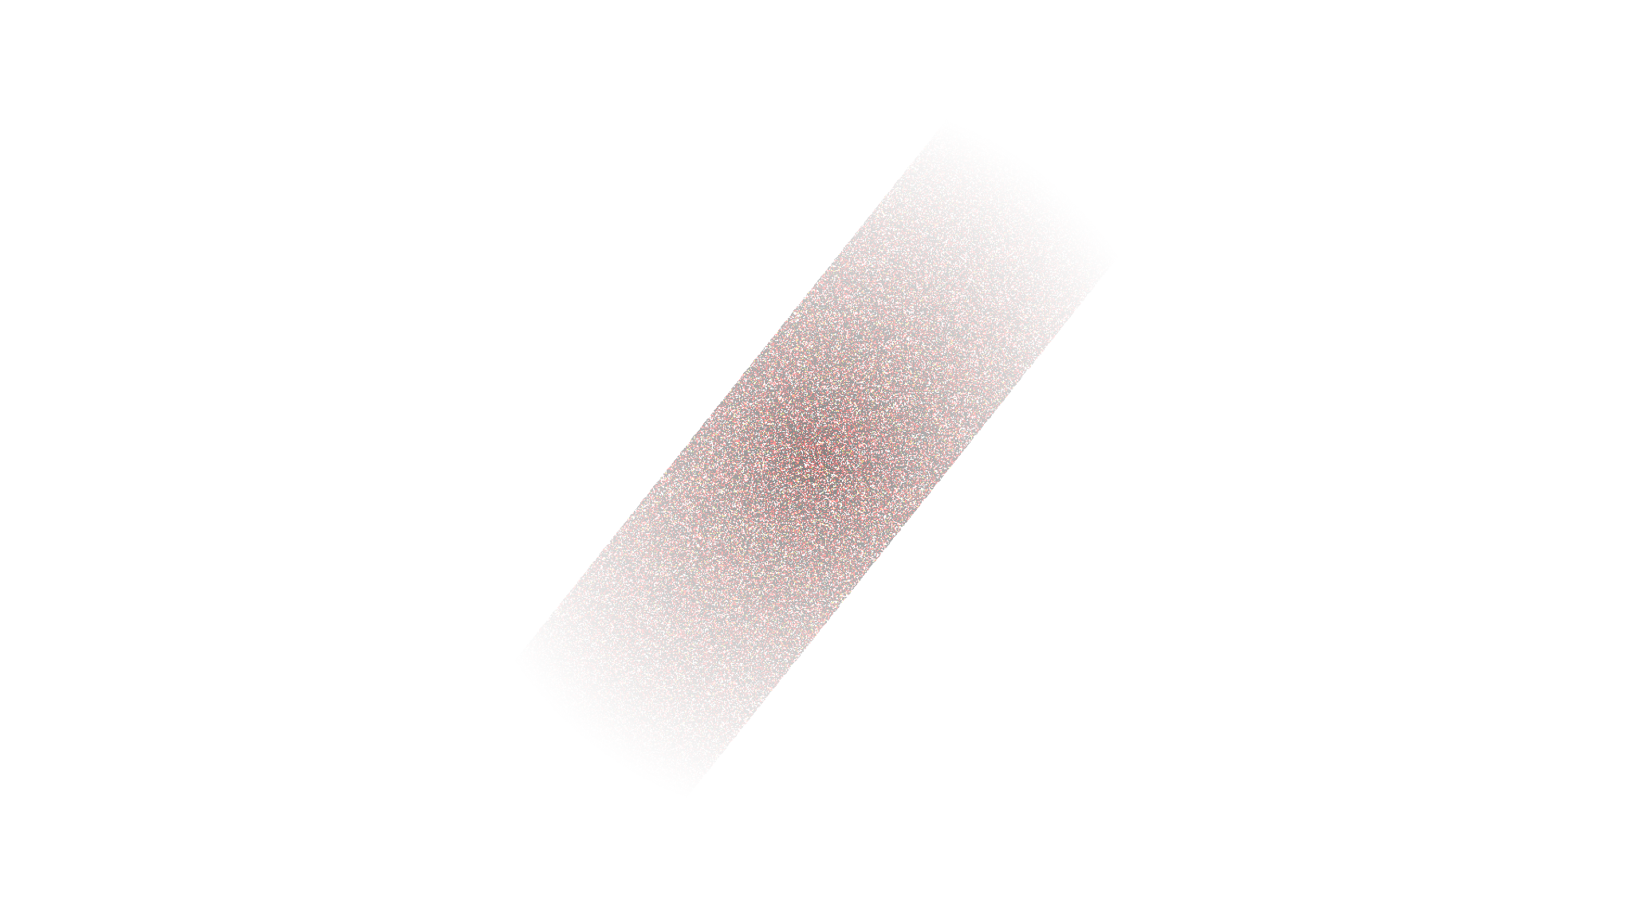
1
Principles of Wound Care
CONTROL OR ELIMINATE CAUSE
SUPPORT THE HOST
2
OPTIMIZE THE WOUND ENVIRONMENT
3
Use the “TIME” framework:
Tissue
Infection
Moisture balance
Edge of wound
Notes:
Control or eliminate the causative factors (incorporate interventions)
For example: Offload pressure, reduce friction/shear, protect from moisture, compression to improve venous return, prevent trauma.
Support the Host
For example: Optimize nutrition & hydration, reduce edema, control blood sugar, smoking cessation, control pain.
Nutrition is very important. Dietitians can help. Protein, carbs, fats, vitamins, & minerals. If unable to consume a balanced diet, consider adding a daily multivitamin
vitamin A (1600-2000 RE per day with wound) - helps with epithelial integrity, protein synthesis, and immune function; good supplement if taking steroids as steroids can delay healing
vitamin C (100-200 mg/day with wound) - helps with collagen synthesis and immune function. Smokers should take 35 mg/day more than nonsmokers.
vitamin E aids in collagen synthesis
protein – helps with collagen synthesis, angiogenesis, wound contraction, immune function, and more. (1.25-1.5 g/kg/day with wound, or 1.5-2 g/kg/day if high exuding wound, otherwise 0.8 g/kg/day). It’s A LOT of protein…may need supplements.
iron – (20-30 mg/day with wound)
zinc, copper, B complex, essential fatty acids – all have important functions. Consuming in healthy foods is best, but a multivitamin is ok.
Fluids (30 ml/kg/day). Proper hydration – decreased blood viscosity decreases perfusion.
Blood Pressure – if low, blood is shunted to vital organs and reduced perfusion to extremities -- increases risk of pressure injury
Smoking - the nicotine causes peripheral vasoconstriction and decreased circulation, increased inflammatory mediators. It takes an hour after smoking a single cigarette to return to baseline levels (Jensen et al, 1991).
Optimize the wound environment using the “TIME” framework:
For example: Remove biofilm, manage infection, cleanse wound, debridement, proper moisture, eliminate dead space, control odor, control pain, protect periwound skin, address epibole & undermining.
“TIME” framework:
Tissue (cleanse & debride to remove the devitalized tissue & biofilm)
Biofilm – “complex community of microorganism embedded in an extracellular matrix of protein, lipids, and polysaccharides that is adherent to the wound or surface.”60% of chronic wounds have biofilm. It has defenses. Sharp surgical debridement to good bleeding tissue is quick & efficient, ultrasound mist is also useful for this, topical dressings (silver, Iodosorb Gel, PHMB) also help.
Slough – fibrin, cell debris, exudate, leukocytes, microorganisms.
Bacteria love devitalized tissue, so that needs to get cleaned up!
Infection (prevent or treat infection)
Moisture balance (not too wet, not too dry – choose appropriate dressing)
Edge of wound (manage epibole or undermining, protect periwound)

Slide 3
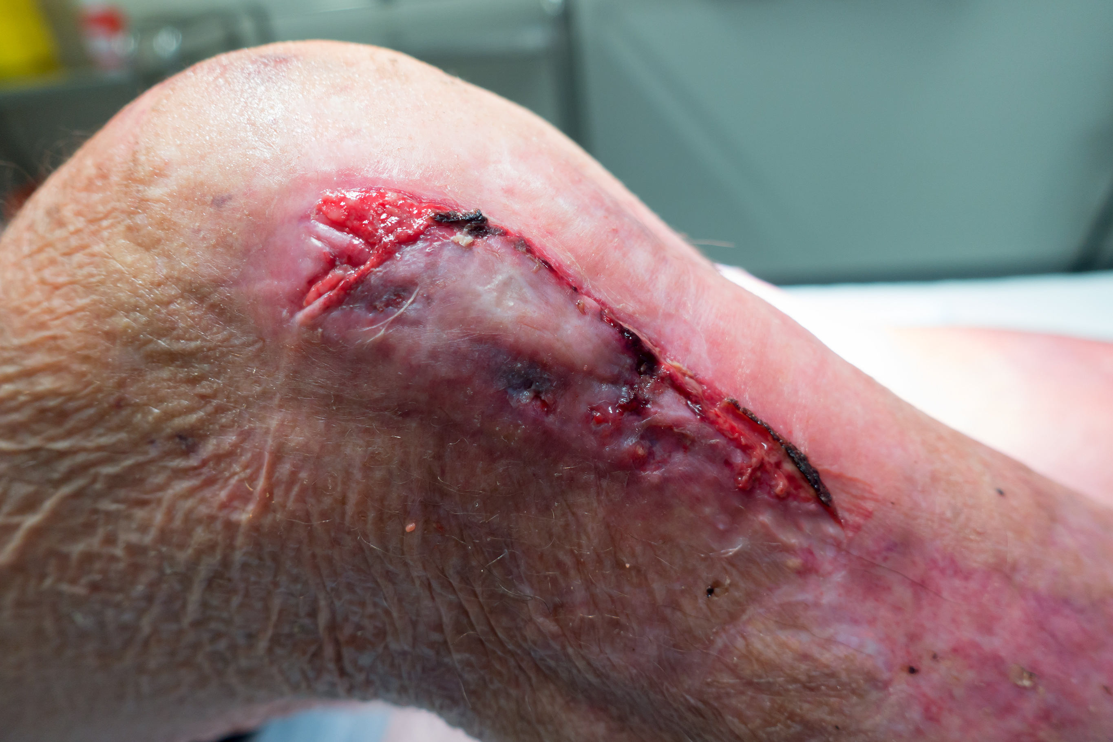
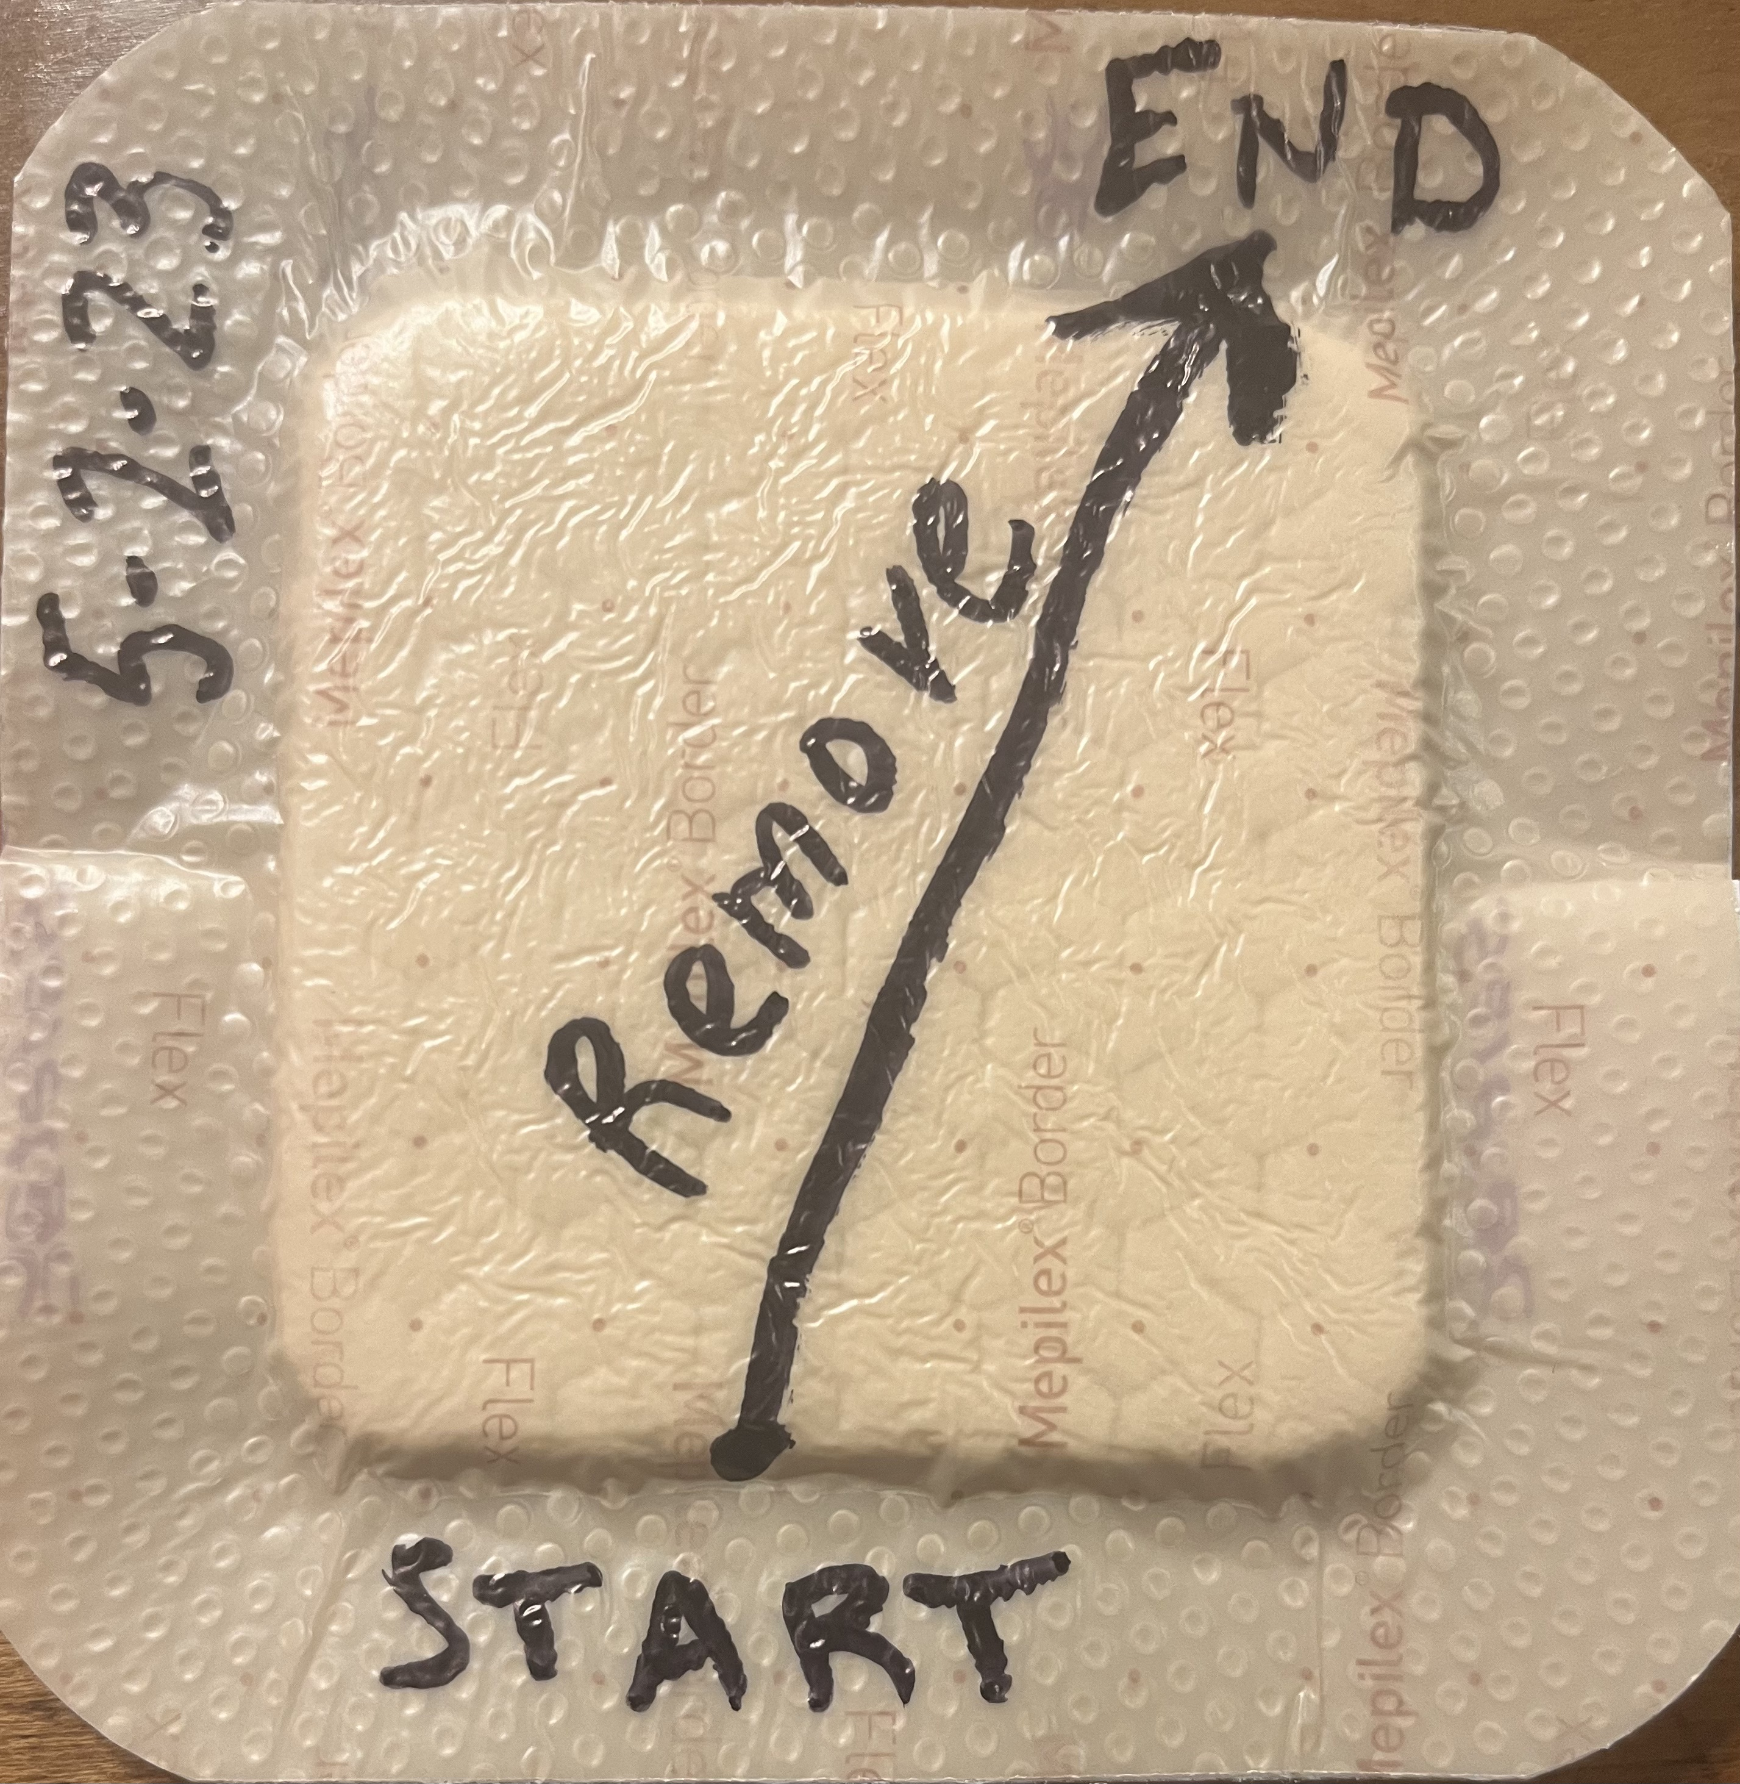
Skin Tears
APPLYING THE PRINCIPLES
Control or eliminate the causative factors
Support the Host
Optimize the wound environment with “TIME”
  Tissue
  Infection
  Moisture balance
  Edge of wound
Notes:
70-80% upper extremities
Prevention is best! Provide safe environment, good nutrition/hydration, wear long sleeves. Frequent bathing with harsh soaps can reduce skins natural oils, so advise gentle pH balanced cleansers and keep skin moisturized.
Advanced age and poor locomotion are a couple risk factors.
DRESSING Goal – maintain a moist wound healing environment, manage drainage, gentle to remove. Consider a gentle dressing that can be placed and left for up to 7 days (depending on drainage), such as foam (ie Mepilex Foam).

Slide 4
Pressure Ulcers
APPLYING THE PRINCIPLES
Control or eliminate the causative factors
Support the Host
Optimize the wound environment with “TIME”
  Tissue
  Infection
  Moisture balance
  Edge of wound
Free resources from
National Pressure Injury Advisory Panel
NPIAP.com
Notes:
Indwelling tubes/drains – reposition daily (ie for urinary catheter, put a securement device on both thighs and switch the tubing every day).
If heel has stable dry intact eschar, don’t remove it…it may have poor arterial flow and removing it increases risk of infection – may paint with betadine
Reposition often. Even if using a low air loss mattress, reposition at least q2h & float heels (pillow under calves to float heels or heel protector boots).
The most severe stage remains the pressure injury identity. For example, a stage 4 never becomes a stage 3 then a 2….it becomes a “healing stage 4” and remains such until it is closed.

Slide 5
Creating Wound Care Protocols
The Iowa Model Revised: Evidence Based Practice to Promote Excellence in Health Care
Identify triggering issues/opportunities
Assemble, Appraise, and Synthesize Body of Evidence
Design and Pilot the Practice Change
Integrate and Sustain the Practice Change
Used/reprinted with permission from University of Iowa Health Care, copyright 2012. For permission to use or reproduce, please contact the University of Iowa Health Care at 319-384-9098. https://uihc.org/iowa-model-revised-evidence-based-practice-promote-excellence-health-carec
Notes:
The Iowa Model Revised: Evidence-Based Practice to Promote Excellence in Health Care© | University of Iowa Health Care
Identify triggering issues/opportunities
Philosophy of care -- Are best practice wound care principles important?
Are residents experiencing issues with wounds?
Is wound care important?
Assemble, Appraise, and Synthesize Body of Evidence
Review current wound/skin care practices and protocols
Do current practices and protocols adhere to best practice wound care principles?
Do current practices and protocols increase risk of poor outcomes?
Design and Pilot the Practice Change
Consider costs and resources (dressing costs, staff time)
Develop protocol appropriate for issues localized in our facility, balancing evidence based wound care with available supplies
Include Medical director, DON, staff nurses, other providers, purchasing
Integrate and Sustain the Practice Change
Identify and engage key personnel
Support staff - have supplies available, offer training
Re-educate as needed

Slide 6
Bartels Wound Care Protocols
INITIAL ATTEMPT TO REVISE WOUND CARE PROTOCOL
Wash with soap/water or wound cleanser before each new dressing. May discontinue skin/wound treatments once healed.
SKIN TEARS, LACERATIONS, & ABRASIONS:
Replace any loose skin flap, if applicable, immediately following a skin tear; may use steristrips to hold skin tear flap in place per nursing judgment.
If small to moderate drainage, cover with foam border (ie Mepilex Border with date), changing dressing 2x/week & PRN per nursing judgement.
If large amount of drainage, dress daily & PRN as follows: Apply Xeroform, cover with ABD pad or gauze, secure per nursing judgement (ie roll gauze/tape or tubular netting).
PRESSURE INJURIES exposed to urine/stool:
For shallow pressure injuries, apply thick layer of barrier cream (ie Desitin).
It is not necessary to remove all the barrier cream when soiling occurs; gently cleanse soiled area and reapply cream where needed to provide protection.
Encourage resident to offload area of injury and to turn/shift often.
PRESSURE INJURIES not exposed to urine/stool:
Cover with foam border (ie Mepilex Border with date) and change twice a week & PRN.
Encourage resident to offload pressure from the area of injury.
CELLULITIS OF UPPER OR LOWER EXTREMITIES:
If cellulitis with edema, encourage resident to elevate affected area above heart level frequently (3-4x/day for 30 minutes each time). If tolerated, light compression may be applied (ie tubigrip or ACE wrap) to help reduce edema, unless contraindicated.
If weeping/open, dress daily & PRN: Apply Xeroform, cover with ABD pad or gauze, secure per nursing judgement (ie roll gauze/tape or tubular netting).
BURNS (MINOR):
Immediately remove burning agent, flush skin with cool water and/or apply cool compress.
After 15 minutes, reassess. If skin remains intact with mild erythema, a soothing lotion may be applied BID PRN.
If skin does NOT remain intact (peels, weeps, or blisters), initiate treatment: Daily apply Bacitracin or TAO ointment, if no allergies, to Xeroform and gently lay over burned area. Cover with dry gauze and/or ABD pad. Secure per nursing judgement (ie roll gauze/tape or tubular netting).
Too wordy

Slide 7

Bartels Wound Care Protocols
DON FINALIZED WOUND CARE PROTOCOL
For all skin/wound orders, wash with soap/water or wound cleanser before each new dressing. May discontinue skin/wound treatments once healed.
MINOR SKIN TEARS, LACERATIONS, ABRASIONS: May steristrip to approximate wound edges. Cover with foam dressing as needed. Monitor for s/s of infection.
PRESSURE INJURIES not exposed to urine/stool: Cover with foam dressing, change dressing 2x/week on shower days.
PRESSURE INJURIES exposed to urine/stool: TID & PRN thick layer of barrier cream after each bm/incontinence episode. Encourage resident to offload area of injury and to turn/shift often.
MINOR BURNS:
Flush with cool water, apply cool compress. If redness continues to be present 15 minutes after cool compress has been applied or skin is no longer intact, notify PCP

Slide 8
In conclusion…
Wound Care Principles
Drive the Protocols
Wound Care Principles
Drive the Protocols
Any questions?
Notes:
OTHER THINGS TO CONSIDER REGARDING WOUND CARE
Review Wound Care Protocol regularly, at least annually
Wound Care Supply Ordering – what will be stocked vs special order? How to bill?
Reinforce & educate on terminology (generic “foam border”, Brand Name example “Mepilex Border”)

Slide 9
References
Bryant R.A., Nix P.N. (2016) Acute & Chronic Wounds Current Management Concepts, 5th Edition. St. Louis, Missouri: Elsevier.
Iowa Model Collaborative. (2017). Iowa model of evidence-based practice: Revisions and validation. Worldviews on Evidence-Based Nursing, 14(3), 175-182. https://doi.org/10.1111/wvn.12223
National Pressure Injury Advisory Panel. (n.d.). NPIAP Free Materials. Retrieved April 23, 2023, from https://npiap.com/page/FreeMaterials
National Pressure Injury Advisory Panel, European Pressure Ulcer Advisory Panel and Pan Pacific Pressure Injury Alliance. Prevention and Treatment of Pressure Ulcers: Clinical Practice Guideline. Emily Haesler (Ed.). Cambridge Media: Osborne Park, Western Australia; 2014.
VanGilder, Catherine; Lachenbruch, Charlie; Algrim-Boyle, Corrine; Meyer, Stephanie. The International Pressure Ulcer Prevalence™ Survey: 2006-2015. Journal of Wound, Ostomy and Continence Nursing 44(1):p 20-28, January/February 2017. | DOI: 10.1097/WON.0000000000000292
Wound, Ostomy and Continence Nurses Society. (n.d.). The WOCN image library [Image database]. Retrieved April 25, 2023, from http://www.wocn.org/page/ImageLibrary
Angie Ellerbroek, RN, BSN, CWON
Infection Prevention Nurse
aellerbroek@bartelscommunity.org

